Slide 1

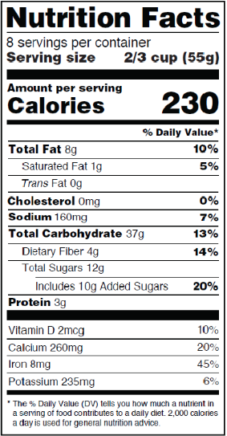
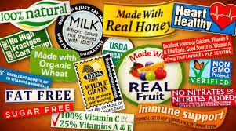
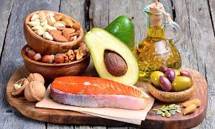
NUTRIENT CLAIMS:
Nutrient claims are claims about the content of certain nutrients or substances in food
Claims like:
“low fat”,
“fat free”
“high in fat”
Are often used when it comes to nutrient content claims made about fat on food labels.
HEALTH CLAIMS:
Health claims refer to the relationship between a specific food product or ingredient and a reduced risk of disease or a health condition
Health claims available for use are either considered:
“Authorized”- FDA approved and allowed on food products to show it may reduce risk of health-related conditions.
“Qualified”- FDA approved and supported by credible scientific evidence.
THE 5/20 RULE:
Choose foods with 5% DV or less of fat per serving. This amount is considered low.
Limit foods with 20% DV or more of fat per serving. This amount is considered high.
NFS: 200 FALL 2018
Amy Gerber-Buchanan,
Amanda Charles, Bruna McPherson,
Meghan Boda, Sarah Bonafede
Contact: 585-820-1451
agerber01@mail.buffalostate.edu
LOOK FOR NEW LABEL COMING SOON
Understanding dietary fats, knowing which types to choose, and healthy recommendations

Slide 2
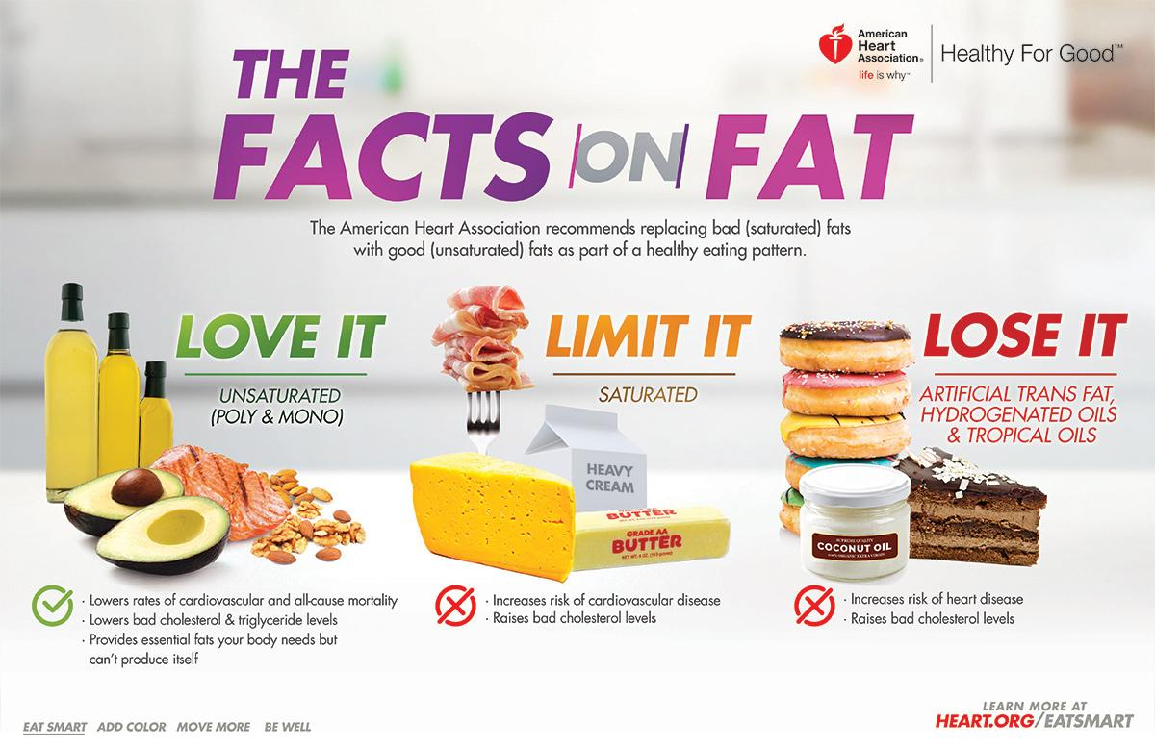
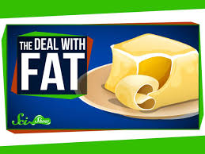
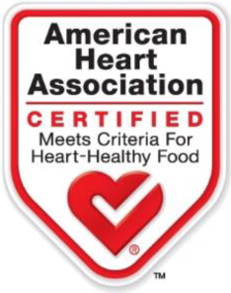
TYPES OF FATS:
Unsaturated - found in plant products; olives, nuts, seeds
Saturated - found in animal products, butter, processed meats, coconut oil, cheese
Trans – found in crackers, microwave popcorn, cakes, cookies, pizza, chips, donuts
ALTERNATIVE
FAT PRODUCTS:
Altering a food may increase the sodium, fiber, cholesterol, sugars, and carbohydrates
Affects the taste, texture, appearance, and aroma as well as baking and cooking
Sugar, fiber, salt, and other ingredients are often added to improve texture and flavor lost when fat is removed
FACTS ON FATS:
Fats are essential to give your body energy of 9 kcal/gram.
They allow for absorption of vitamins A, D, E and K
Saturated and trans fats can increase risk of cardiovascular disease
EFFECTS OF FAT ALTERNATIVE FOODs:
Calories may increase due to sugar
Fiber often increases due to additives
Sodium (salt) increases to compensate for flavor lost from fat
LOW FAT DOES NOT ALWAYS MEAN LOW
Food products are altered to decrease the amount of fat
DAILY VALUE DIETARY FAT GUIDELINES:
The Daily Value (DV) for overall fat is 20% to 35% of total calories from fat. This is about 77 grams/day based on a 2,000 calorie diet.
FAT AWARENESS:
Avoid intake of trans fats due to health risks
Limit consumption of saturated fats and dietary cholesterol
Reduce intake of trans fats
Increase foods containing monounsaturated or polyunsaturated fats, such as nuts, seeds, seafood, and oils (canola, olive, peanut)

