Slide 1
Foodborne Pathogens
Food Safety Presentation
October 15, 2018
NFS 200
Amy Gerber-Buchanan, Ben Kraemer, Steve Warden, Sarah Bonafecle

Slide 2
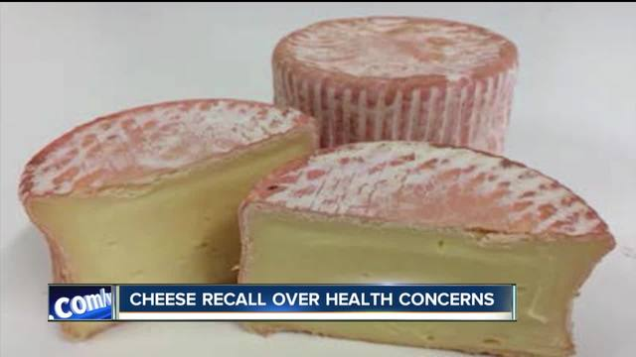
Listeriosis Outbreak Linked to Soft, Raw Milk Cheese
Vulto Creamery - Ouleout soft cheese
Sold to retail in Northeastern and Mid-Atlantic states
Cause of 8 illnesses, 2 deaths

Slide 3
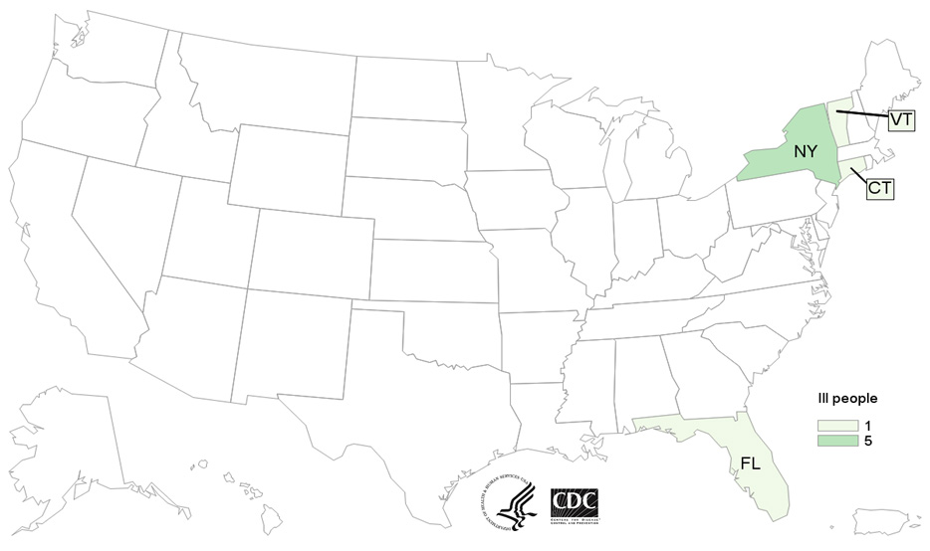

Listeria Monocytogenes pathogen
causes bacterial infection, Listeriosis
Symptoms: flu-like (muscle aches, fatigue, headache, fever)
Invasive (spread beyond the gut): high risk when pregnant
Investigation: conducted by state and public health regulatory officials
Public health investigators (PulseNet & WGS)
Center for Disease Control and Prevention
Food and Drug Administration

Slide 4
All lots of Vulto Creamery cheese recalled
All types of cheese recalled on March 11th, 2017
Unsanitary conditions in the workplace most likely cause of Listeria
Vulto Creamery shut down in April 2017 until coming into compliance with legal requirements
Vulto “lacked the knowledge and understanding to make the corrections and become compliant with the legal requirements”

Slide 5
The SoyNut Butter Company Recall
March 28, 2017, FDA suspended the Food Facility Registration for Dixie Dew, the contract manufacturer for The SoyNut Butter Company
Inspections of the facilities found insanitary conditions that could cause E. Coli
Further investigation by FDA and CDC found an outbreak of Shiga toxin-producing E. Coli O157:H7
Specific products affected:
  Dixie Diner’s Club brand Carb Not Beanit Butter
  All flavors and sizes of I.M. Healthy SoyNut Butters
  All flavors and sizes of I.M. Healthy Granola
  Pro Sports Club 20/20 Life Styles Yogurt Peanut Crunch Bars

Slide 6
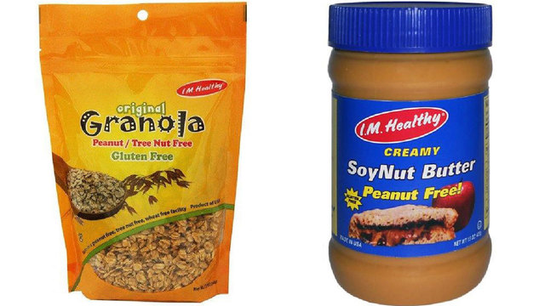
Production Facility Issues
Major concerns found:
  Walls and ceilings in the soynut butter processing and packaging rooms were heavily coated with old soynut butter build-up
  Visible standing water and brown/black filth was found on the processing room floors
  Wooden pallets resting on the floor were sitting in water and covered in black mold
A combination creating the perfect storm for bacterial growth

Slide 7
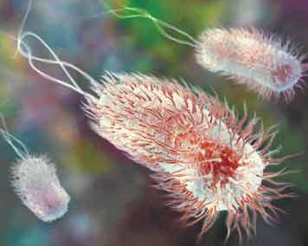
E. coli 0157:H7
32 cases of infection spanning a crossed 12 different states
12 hospitalizations, 9 developed hemolytic uremic syndrome, 0 deaths
Symptoms vary, but often experience severe stomach cramps and bloody diarrhea
Can last 5-7 days if non life-threatening
5-10% of cases lead to hemolytic uremic syndrome

Slide 8
E. coli O157:H7 Outbreak Linked to Romaine Lettuce
April 13th, 2018 the FDA stated that there had been an ongoing E.coli outbreak linked to chopped Romaine Lettuce.
On April 19th, 2018 eight people from a correctional facility in Alaska that were apart of the recent outbreak became ill from E. coli O157:H7 from whole head romaine lettuce from Yuma, Arizona growing region.
The FDA publicly stated to customers to avoid romaine Lettuce from Yuma, AZ growing region.
The symptoms are different from each person, but often include:
  Vomiting
  Stomach Cramps
  Bloody Diarrhea

Slide 9
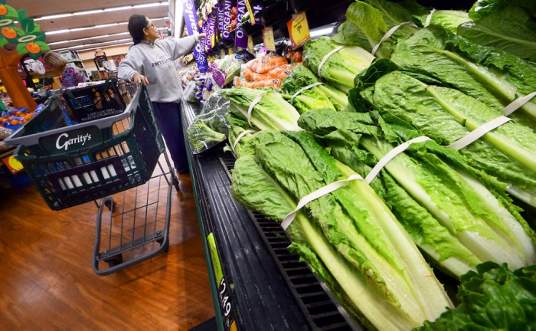
Recalls?
The FDA could not recall any romaine lettuce being that on May 2nd, 2018 the FDA had just received information that Yuma, AZ growing region was no longer producing or distributing romaine. When there growing season had ended April 16th, 2018.
The FDA stated that they could not be certain that the romaine lettuce from Yuma, AZ was no longer on the supply chain due to its 21 day shelf life.

Slide 10
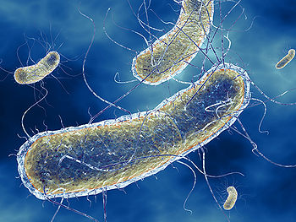
The Investigation Continues
Throughout June 4th through June 8th the FDA, CDC, along with local partners of both agencies conducted an Environmental assessment in Yuma, AZ growing region.
During this assessment it was discovered that the canal waters of this region were contaminated with E. Coli O157:H7.
It was hypothesized that The Concentrated Animal Feeding Operation (CAFO) had contaminated the canal water.
The outbreak ended on June 28th, 2018. It was stated that there were 210 cases throughout 36 states. Ninety six people were hospitalized and 5 people died

Slide 11
Summary
So where do these foodborne illnesses come from?
E Coli - undercooked hamburger, contaminated produce, unpasteurized milk, source of water
Listeriosis - meats, dairy products that are not pasteurized, contaminated vegetables
“CDC estimates that each year roughly 1 in 6 Americans (or 48 million people) gets sick, 128,000 are hospitalized, and 3,000 die of foodborne diseases.”
Questions?
Comments?

Slide 12
References
Listeriosis Outbreak Linked to Soft, Raw Milk Cheese
Center of Disease Control and Prevention: https://www.cdc.gov/listeria/outbreaks/soft-cheese-03-17/index.html
Food Safety News: https://www.foodsafetynews.com/2018/04/vulto-creamery-shut-down-because-owner-did-not-understand/
The SoyNut Butter Company Recall
Center for Food Safety and Applied Nutrition. (n.d.). Outbreaks - FDA Investigated Multistate Outbreak of E. coli O157:H7 Infections Linked to SoyNut Butter. Retrieved October 10, 2018, from https://www.fda.gov/food/recallsoutbreaksemergencies/outbreaks/ucm544964.htm
Hageman, P. (n.d.). 9 with Hemolytic Uremic Syndrome from SoyNut Butter, Lawsuit Filed. Retrieved October 10, 2018, from https://www.pritzkerlaw.com/personal-injury/2017/9-with-hemolytic-uremic-syndrome-linked-to-soynut-butter-lawsuit-filed/
E. coli O157:H7 Outbreak Linked to Romaine Lettuce
Center for Food Safety and Applied Nutrition. “Outbreaks - FDA Investigating Multistate Outbreak of E. Coli O157:H7 Infections Linked to Romaine Lettuce from Yuma Growing Region.” U S Food and Drug Administration Home Page, Center for Food Safety and Applied Nutrition, 6 Aug. 2018, www.fda.gov/food/recallsoutbreaksemergencies/outbreaks/ucm604254.htm
“E.coli (Escherichia Coli).” Centers for Disease Control and Prevention, Centers for Disease Control and Prevention, 28 June 2018, www.cdc.gov/ecoli/2018/o157h7-04-18/index.html.
Staff. “Romaine Lettuce Outbreak: FDA Identifies Cattle Operation Near Contaminated Canal Water.” Food Safety Magazine, 7 Aug. 2018, www.foodsafetymagazine.com/news/romaine-lettuce-outbreak-fda-identifies-cattle-operation-near-contaminated-canal-water/
CDC - 2011 Estimates of Foodborne Illness http://www.cdc.gov/foodborneburden/2011-foodborne-estimates.html

