Slide 1
The Giving Garden
NFS 111 Management - Fall 2017
By: Amanda Charles, Joshua Trubits, Amy Gerber-Buchanan, Dale Wesolowski

Slide 2
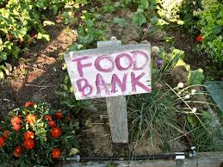
What is the “Giving Garden”?
Our project involves the following:
Building and maintaining a greenhouse and outdoor garden at Buffalo State College.
It will be maintained through a collaboration between the Health, Nutrition and Dietetics Department, the Health and Wellness Department, Chartwells (Buffalo State Dining Services), and Milligan’s Food Pantry (Buffalo State's on-campus food pantry for students in need can receive nonperishable items).
Provide an educational component to increase awareness of nutritious meals, the concept of farm to table practices, eating within the seasons, and being a locavore.
Supplementing the existing food pantry with fresh produce items.
Hosting health & wellness fairs to promote healthy habits encompassing good nutrition, exercise tips, and increase awareness of the benefits of making healthy food choices.

Slide 3
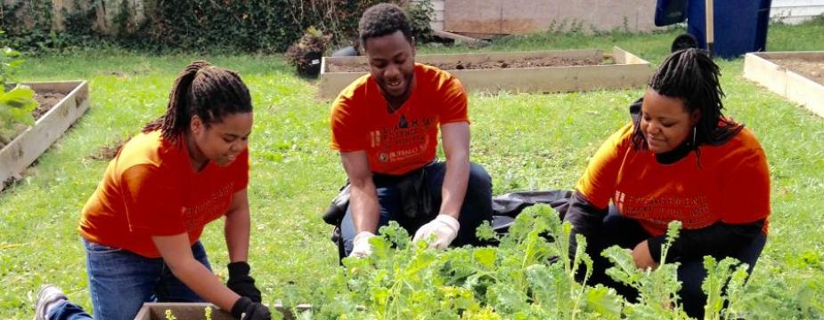
Our audience is...
Buffalo State College Students who may have food insecurities.
With our program, we want to reach out to students who:
Do not have the funds for fresh produce
Do not have access to fresh produce
Need to optimize their diet due to food shortages
Desire to gain knowledge of gardening/food cultivation (this may pertain to volunteers)

Slide 4
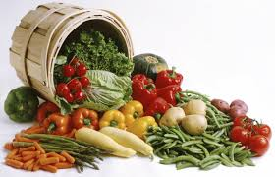
Our Mission Statement
“Our mission is to provide Buffalo State college students who are experiencing food insecurity the means to obtain fresh produce to supplement and help nourish their bodies in order to live active, healthy lives while focusing on their education. Not having enough food or proper nutrition impacts a student’s ability to focus, study, and succeed. The Giving Garden is committed to providing education on nutrition and food preparation, promote sustainable gardening practices, connect people to nature and local foods, and to build a healthier community one seed at a time.”

Slide 5
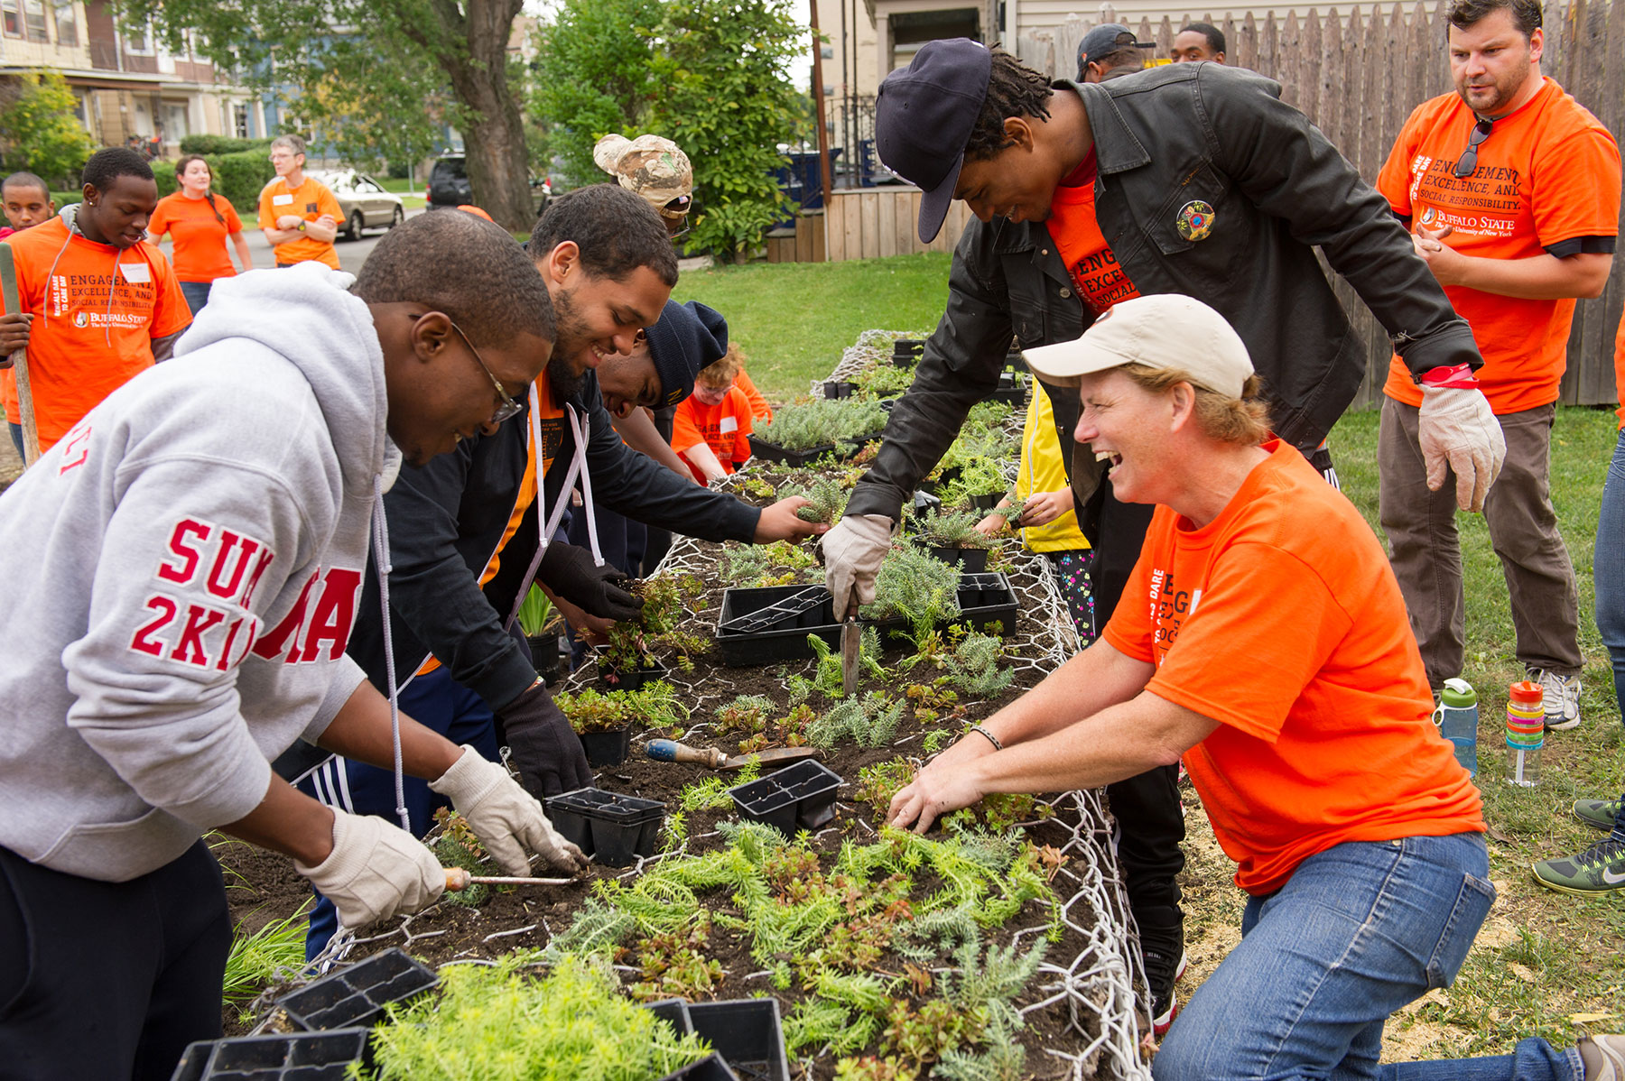
Our Core Values
Treat everyone with respect and equality.
Be open to change and flexibility.
Have an open mind and heart.
Strive for farm to table practices by eating within the seasons.
Encourage being a locavore.
Build a sense of community.

Slide 6
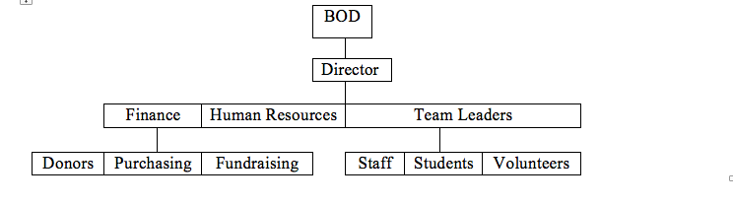
Our organization of hierarchy
Board of directors- Are volunteers as well that oversee the business and operations. They jointly oversee the activities of our organization.
Chief Executive Officer- is the one who answers to the board of directors and they make sure they relay the message to those in middle management like those in finance, human resources, and our team leaders.
Finance- those in finance oversee who donates to our organization they also cover purchasing supplies and creating fundraisers to help purchasing supplies
Human Resources- Our HR Department are concerned with the management of people within organizations and focusing on policies and systems. Not only does the Department do that,they also try to motivate an effective and qualified workforce.
Team leaders- Are Project Facilitators/Coaches who organize the team, develop team’s skills and abilities, and establish its purpose. They develop strategies to get the job done and if needed they remove organizational impediments that block the team’s progress

Slide 7

Our business style...
Traditional Management
To both classical and contemporary approaches from:
Systematic Management (Classical): integration of specific procedures and processes into operations. Ensure coordination of effort and achieve established goals and plans.
Systems Theory (Contemporary): system that changes inputs into outputs that ideally meet the market’s needs for goods and services. ·

Slide 8
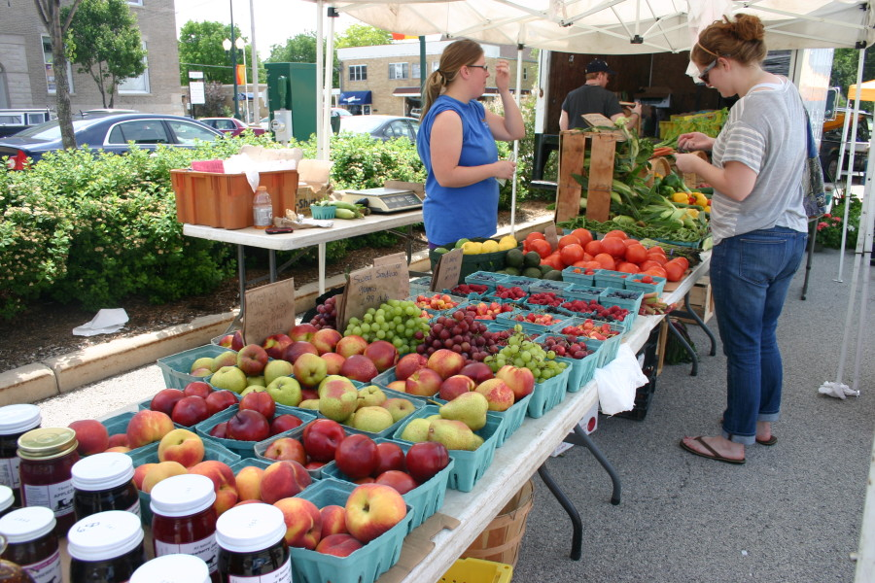
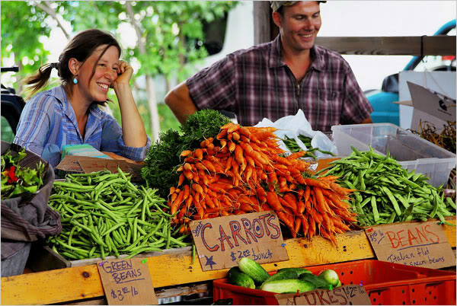
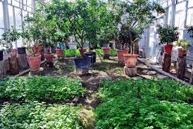
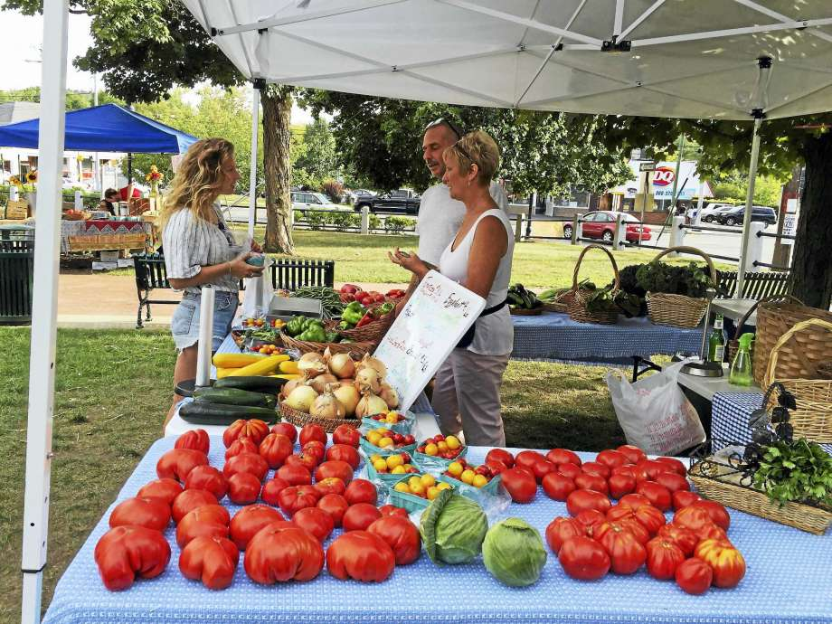
Store Plans and it’s Set-up
Floor plan
Green House
Store front

Slide 9

What Worked for Us
When working on this project, we met as a group on Friday’s along with conference calls on Thursdays
Answering each question individually and deciding as a group
Comparing and contrasting our ideas
We discussed disagreements and agreed upon compromises
Google Docs and Slides for group works
Group text messaging for communication outside the classroom
Facetiming when needed for meetings while in different cities

Slide 10
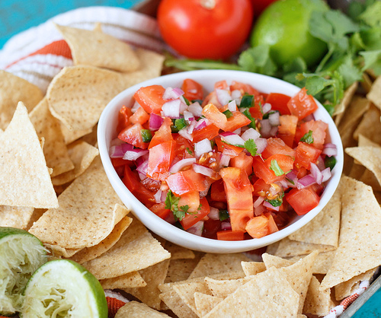
Samples Anyone?
Pico de Gio
Any questions?

