Slide 1
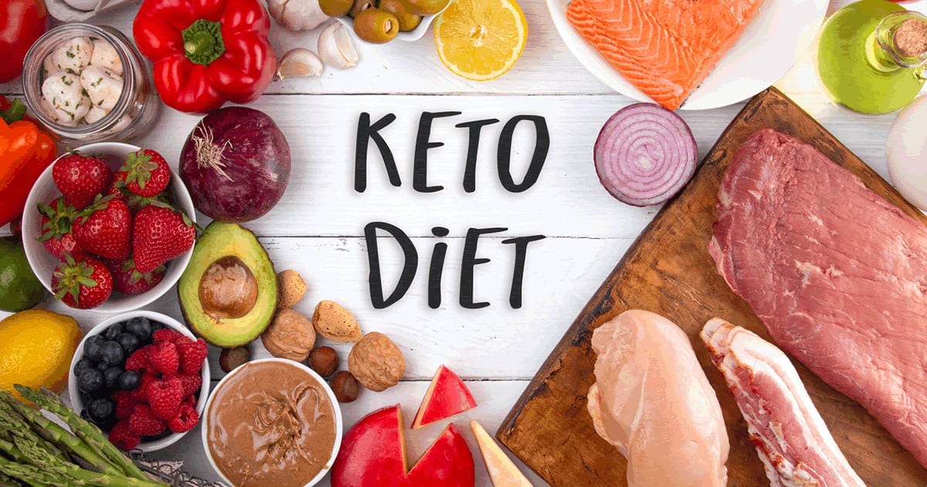
Presented By: Amy Gerber Buchanan

Slide 2
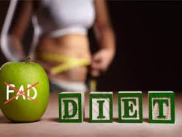
What Is A Fad Diet?
A fad diet is a diet that is popular for a time, without being a standard dietary recommendation, and often promising unreasonably fast weight loss.
Some of these diets involve eliminating foods that contain necessary nutrients that your body needs to maintain good health.

Slide 3
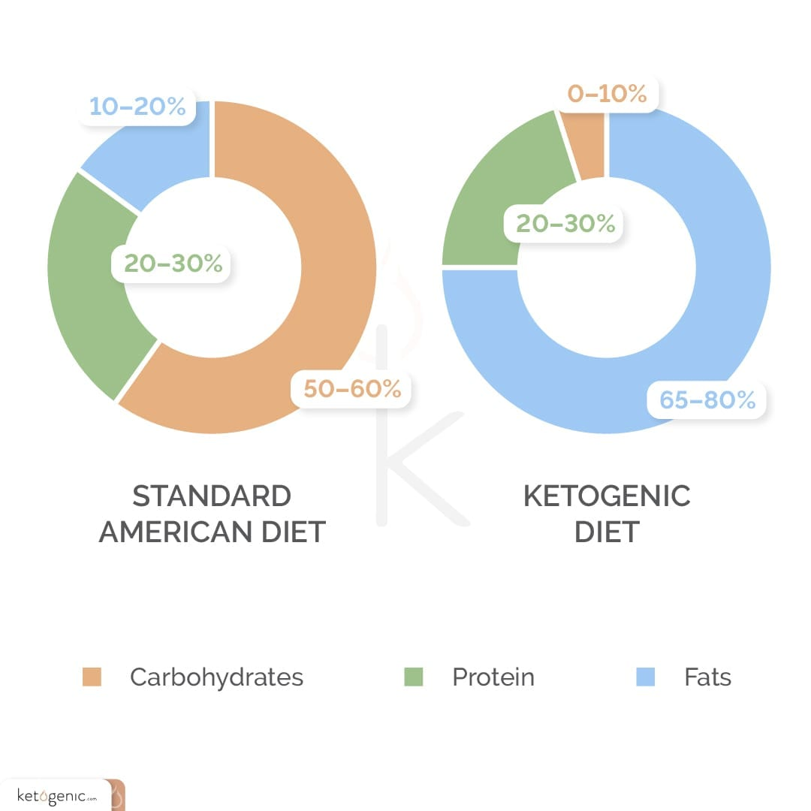
What Is The Keto Diet?
It involves consuming low carbohydrates, high fat, with moderate protein that is aimed at helping with the lose of weight.
It was first used as a treatment in the 1920’s to treat epilepsy. The keto diet has gained huge popularity within the past several years.
It consists of a 4:1 ratio of fats to carbs plus protein with a reduced caloric intake of 25%.
It is an adjustment in the ratio of macronutrients consisting of 5%-15% carbs, 25%-35% protein, and 60%-75% fat.
Typical consumption of carbs while on the keto diet is between 20g–50g carbs per day.

Slide 4
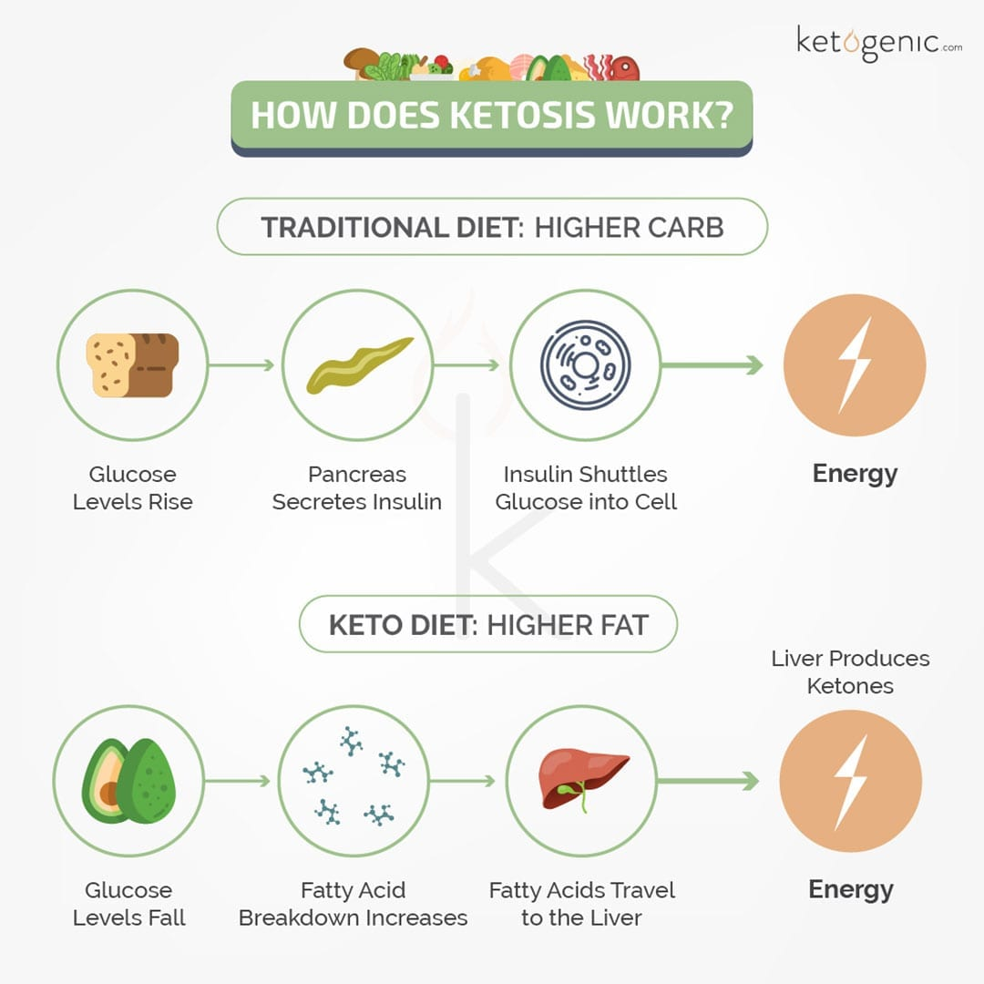
How Does Keto Work?
It aims to get dieters in a metabolic state called ketosis, where the drastic drop in carbs, forces your body to burn fat for energy.
The chemicals responsible for this process are called ketones.

Slide 5
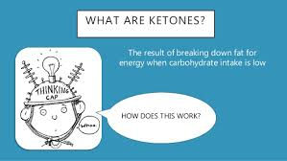
What Are Ketones?
They are chemicals your liver makes. You produce them when you do not have enough insulin in your body to turn sugar (or glucose) into energy. You need another source, so your body uses fat instead. Your liver turns this fat into ketones.

Slide 6
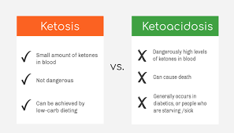
What Is Ketosis?
Ketosis is your body’s natural metabolic state. When in ketosis, your body produces ketone bodies out of fat and uses these ketones for energy instead of carbs.

Slide 7
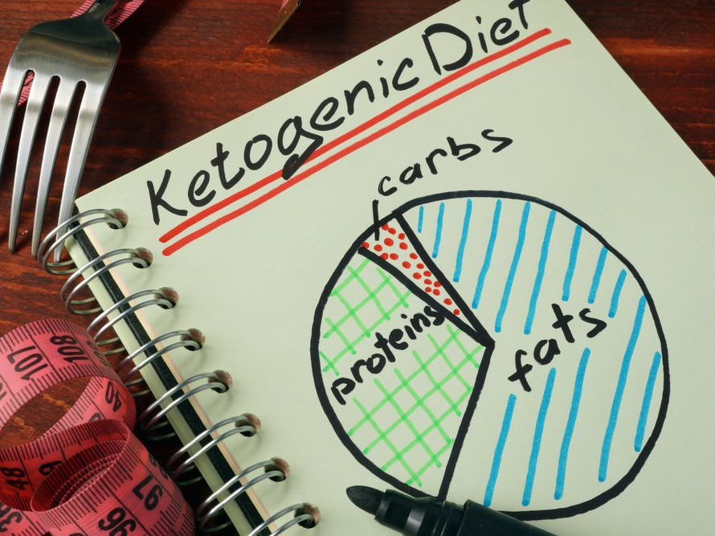
How Do You Get Into Ketosis?
The keto diet focuses on consuming high-fat, moderate protein, and low carbohydrate intake. This forces your body to use fat for energy.

Slide 8
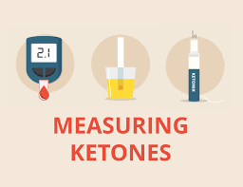
How Do You Know When You Are In Ketosis?
The best way to know if you are in ketosis is by blood testing for ketones. There are now a variety of over-the-counter kits available to purchase such as urine and breath tests.

Slide 9
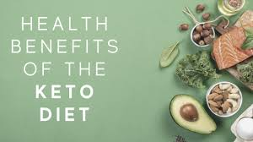
Why Keto?
Keto was originally used in medicine to help patients control epilepsy.
Because it allows the body to maintain a low but healthy level of glucose, it can also be beneficial for people with type 2 diabetes.
Keto is also widely being used for a rapid weight loss option.

Slide 10
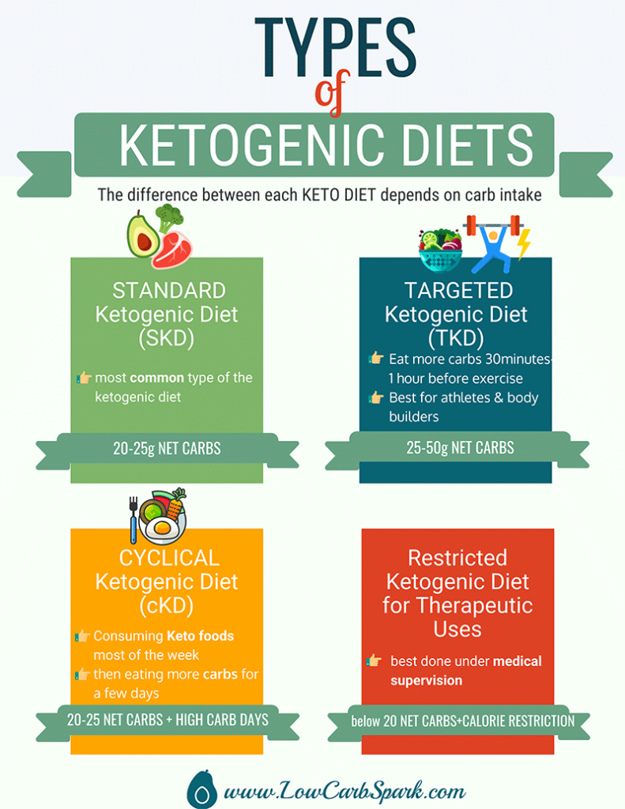
What Are The Different
Types of Keto Diets?
Standard Ketogenic diet (SKD)
Targeted ketogenic diet (TKD)
Cyclical ketogenic diet (CKD)
High-protein ketogenic diet (HPKD)

Slide 11
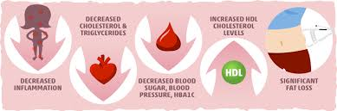
What Are The Advantages of The Keto Diet?
Aids in weight loss, metabolic syndrome, lowers blood sugar levels, reflux symptoms, hypertension, inflammation, obesity, diabetes, increases insulin sensitivity, lowers risk of cancer, improves mood and mental clarity, heart health, treats seizures, neurological disorders, hyperlipidemia, preserves muscle mass, improves fat burning abilities, increases energy levels, and appetite satiety.

Slide 12

What Are The Disadvantages of The Keto Diet?
Severe rapid weight loss, low blood pressure, constipation, fatigue, nausea, headache, abdominal pain, dizziness, and hair loss. These short-term side effects are sometimes referred to as “keto flu”. While on a strict long-term keto diet there could also be an increased risk of ketoacidosis, nutrient deficiencies, heart disease, kidney stones, social isolation, or disordered eating. There may also be the possibility of yo-yo effects “weight cycling” once off the diet.

Slide 13
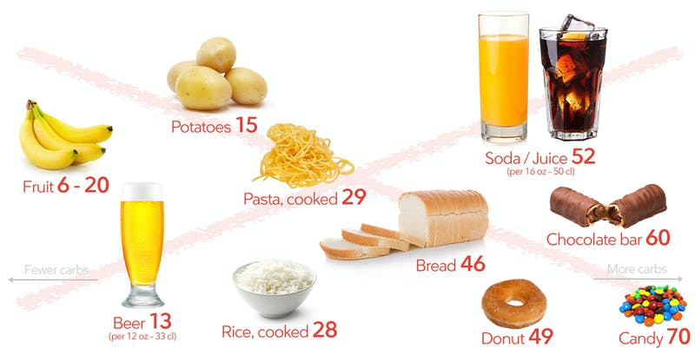
What Foods Are Typically Restricted While On A Keto Diet?
The diet restricts or limits foods such as grains, beans, baked goods, ice cream, candy, soft drinks, breads, pastas, artificial sweeteners, “low fat” or “diet” foods, certain fruits, starchy vegetables, vegetable oils, processed foods, sweetened beverages, juices, milk, alcohol, and sugar.
It is much more difficult to obtain all required nutrients, particularly fiber and B vitamins.
A strict keto diet should be conducted under dietetic supervision and consideration given to supplementation with a multivitamin including trace minerals.

Slide 14
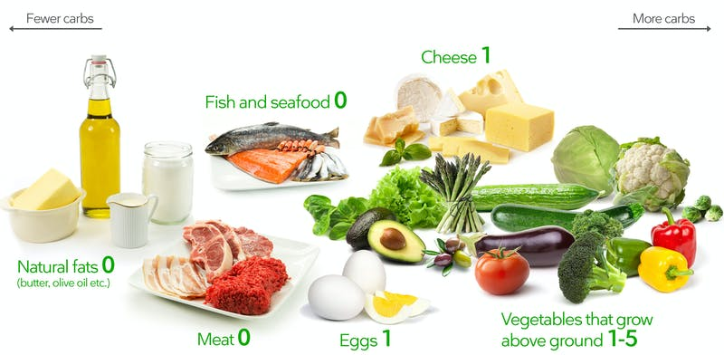
What Foods Are Typically Allowed While On A Keto Diet?
A typical keto plate should be built on whole foods that consist of eggs, cheese, greek yogurt, butter, heavy cream, cottage cheese, bacon, avocados, nuts, seeds, low-carb vegetables such as cauliflower, mushrooms, spinach, tomatoes, brussel sprouts, and asparagus, coconut, flax, and olive oils, almond butter, fish and seafood, high quality poultry and grass-fed beef, berries, ghee, dark chocolate, and drinks such as water, bone broth, tea, and coffee.
Fat intake on keto consists of saturated, monounsaturated fats, polyunsaturated fats,
The use of MCT oils is used to induce ketosis.
Intermittent fasting sometimes is used to stimulate ketosis.

Slide 15
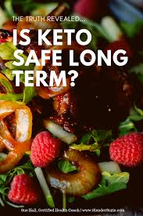
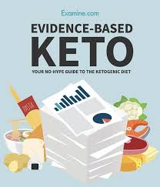
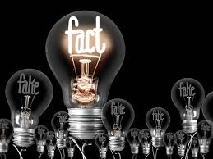
What Is The Success Rate Of The Keto Diet?
While there have been strong supportive evidence and positive results as well as many positive public reviews that weight loss is significant while on a ketogenic diet, there is insufficient data on how effective keto works regarding its long-term effects on the body.

Slide 16
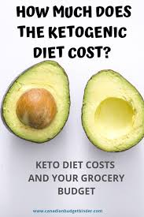
What Is The Cost Of Going On A Keto Diet?
Various health and social media apps, blogs, books, podcasts, programs, and recipes are out there that have many variations of the keto diet.
Some charge, while some are free such as Carb Manager, My Fitness Pal, and Senza.
Purchasing items/food pertaining to this diet can be somewhat costly depending on the type of keto platform you are implementing into your diet.
While it may be challenging to navigate, it is important to do your research first as well as consult with an RD or primary care provider before starting any weight-loss program or diet.

Slide 17
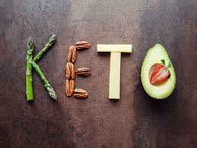
In Conclusion:
Implementing a keto diet in short-term for weight reduction can be effective to treat obesity and type 2 diabetes, while long-term effects are inconclusive.
As with any nutritional adjustments concerning dieting, exercise is also an important factor for a healthy lifestyle balance.
As a dietitian it is important to monitor, educate, counsel, and communicate a nutritional care plan to your client.

Slide 18
Sources:
https://www.ncbi.nlm.nih.gov/pmc/articles/PMC6566854/
https://www.ncbi.nlm.nih.gov/pmc/articles/PMC3945587/
https://www.ncbi.nlm.nih.gov/pmc/articles/PMC2716748/
https://www.ncbi.nlm.nih.gov/pmc/articles/PMC6251269/
https://www.ncbi.nlm.nih.gov/books/NBK499830/
https://ketogenic.com/why-keto-isnt-just-another-fad-diet/
Krause’s Food & the Nutrition Care Process, 14th Edition

Slide 19
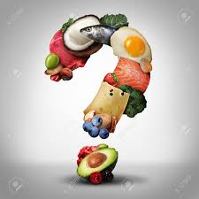
Questions?

